Slide 1
Information Sharing, Holdup, And External Finance: Evidence from Private Firms
Andrew Bird Carnegie Mellon University
Stephen A. Karolyi Carnegie Mellon University
Thomas G. Ruchti Carnegie Mellon University
Presented by Austin Francis

Slide 2
Research Question
How does voluntary information sharing by private borrowers affect lender competition, borrower switching behavior, loan financing costs, and financial constraints?

Slide 3
Prior Literature
There is information asymmetry in lending relationships (Hauswald and Marquez, 2006; Schenone, 2010; Bharath et al., 2007).
Winner’s curse for outside lenders (Sharpe, 1990; Rajan, 1992; Berger and Udell, 1995; Petersen and Rajan, 1994).
Voluntary information sharing reduces spreads (Petersen and Rajan, 1994).
Proprietary costs reduce likelihood of information sharing (Bhattacharya and Ritter, 1983; Verrecchia, 1983; Darrough and Stoughton, 1990).
Notes:
Relationship lenders often acquire private information about borrowers, creating an information asymmetry that makes it costly for borrowers to switch lenders. This allows relationship lenders to increase loan spreads and hold up borrowers
Potential outside lenders face a winner’s curse when competing to lend to a borrower with an incumbent lender, as the outside lenders are less informed
Borrowers respond to information asymmetry by publicly sharing information, which reduces loan spreads by increasing lender competition

Slide 4
Data Collection
LPC Dealscan database for borrower, lender, loan characteristics, and data on financial disclosures

Slide 5
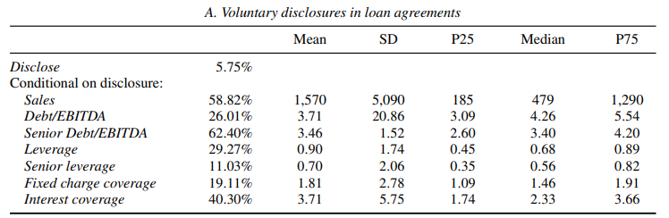
Table 1 – Summary Statistics

Slide 6
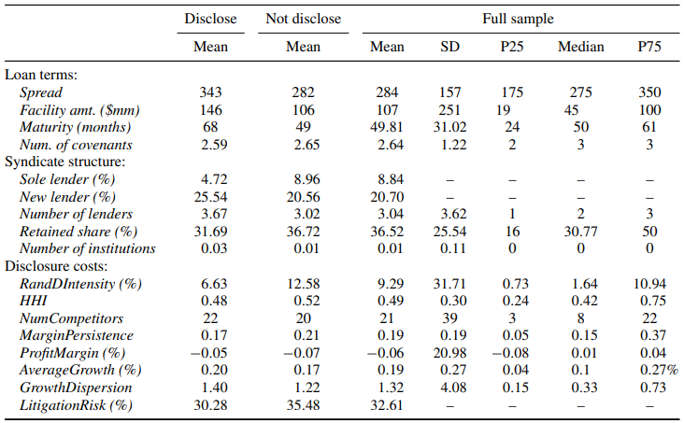
Table 1 – Summary Statistics

Slide 7
Table 1 Takeaways
A small percentage of firms (5.75%) disclose.
Sales, Senior Debt/EBITDA, Interest Coverage are most disclosed
Loans with Disclosures have more favorable terms
Disclosers are less likely to borrow from sole lenders and more likely to initiate loans with a new lender
Notes:
Higher spreads (343 bps for disclosers vs. 282 bps for non-disclosers).
Larger loan amounts ($146 million for disclosers vs. $106 million for non-disclosers).
Longer maturity (68 months for disclosers vs. 49 months for non-disclosers).

Slide 8

Empirical Design
Notes:
Disclose = dummy variable
X = loan controls from loan agreement
W = borrower fixed effects
U = lender fixed effects
V = year fixed effects

Slide 9
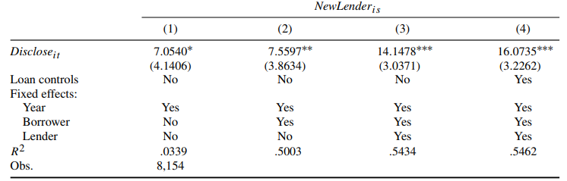
Table 2 - Voluntary disclosure and future lender choice

Slide 10
Table 2 Takeaways
Disclosure leads to a higher chance of working with a new lender, regardless of the varying fixed effects

Slide 11
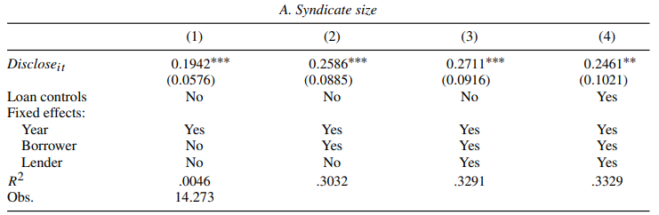
Table 3 – Voluntary disclosure and future syndicate structure

Slide 12
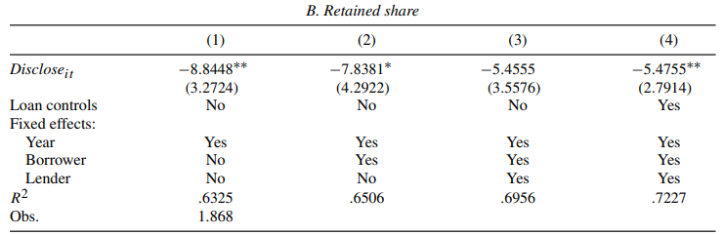
Table 3 – Voluntary disclosure and future syndicate structure

Slide 13
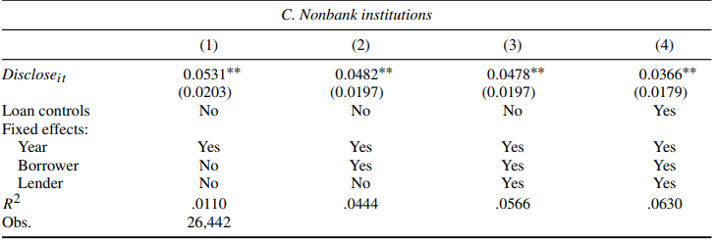
Table 3 – Voluntary disclosure and future syndicate structure

Slide 14
Table 3 Takeaways
Disclosing firms see an increase in the number of lenders in the syndicate
They also see the retained share of the lead arranger decrease
Increase share of nonbank institutions

Slide 15
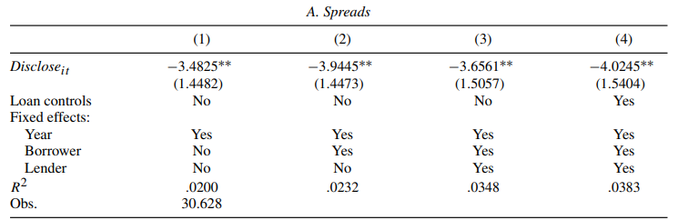
Table 4 – Voluntary Disclosure and Future Loan Terms

Slide 16
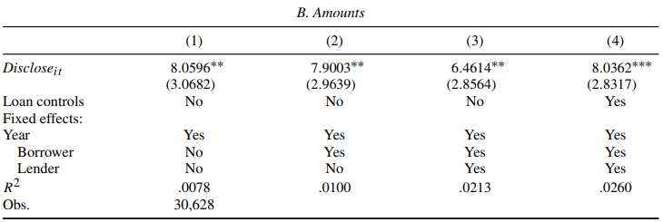
Table 4 – Voluntary Disclosure and Future Loan Terms

Slide 17
Table 4 Takeaways
Disclosing firms benefit from lower spreads in their next loan
They also benefit from increased loan amounts
Notes:
Debt is issued at a lower rate due to the hypothesis that debt becomes more expensive and is rationed.

Slide 18

Empirical Design Part 2
Notes:
Cost benefit is one of the several measures of the cost or benefits of disclosure
X = set of loan controls

Slide 19
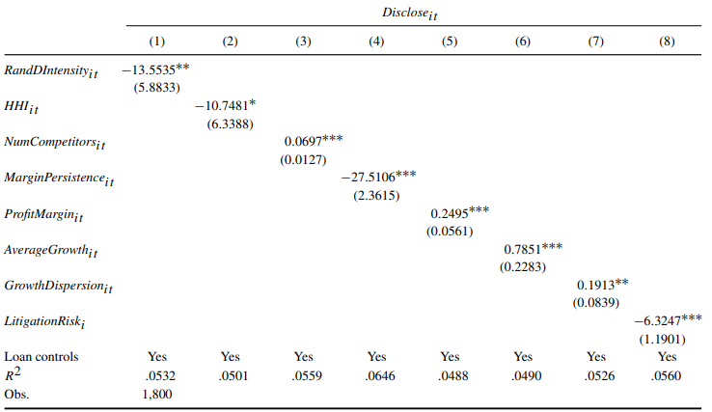
Table 5 – The Costs of Voluntary Disclosure

Slide 20
Table 5 Takeaways
More disclosure is associated with less R&D Costs
Firms in industries with higher concentration are less likely to disclose
Higher profit margins lead to more disclosure
Notes:
R&D Intensity (Column 1): Higher R&D intensity, which implies greater proprietary costs, is associated with less disclosure. This suggests that innovative firms with significant research and development efforts are more cautious about sharing information due to concerns about competition.
Industry Concentration (Column 2): Firms in industries with higher concentration, as measured by the Herfindahl-Hirschman Index (HHI), are less likely to disclose information. This indicates that firms with more market power or monopoly-like status avoid sharing information to protect competitive advantages.
Number of Competitors (Column 3): A greater number of competitors in an industry increases the likelihood of disclosure, as firms are more willing to share information in more competitive environments where sharing may help secure favorable loan terms.
Margin Persistence (Column 4): Firms in industries with more stable profit margins are less likely to disclose information. This suggests that in industries where profitability is predictable, firms are more cautious about sharing information that could benefit competitors.
Profit Margin (Column 5): Higher profit margins are associated with more disclosure. Firms in high-margin industries may have more favorable information to share, which could lead to better loan terms.
Average Growth (Column 6): Firms in industries with higher sales growth are more likely to disclose. This could reflect a willingness to share positive financial news to obtain better financing.
Growth Dispersion (Column 7): Higher variability in industry sales growth leads to more disclosure, suggesting that firms use disclosure to distinguish themselves in volatile industries.
Litigation Risk (Column 8): Firms in high litigation-risk industries are less likely to share information. The potential legal consequences of disclosing sensitive financial data outweigh the benefits of voluntary disclosure in these industries.

Slide 21
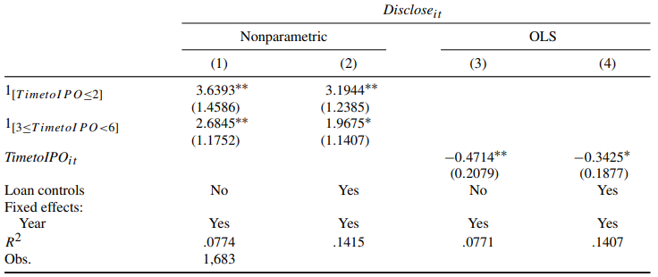
Table 6 – Voluntary Disclosure Before Initial Public Offerings

Slide 22
Table 6 Takeaways
Borrowers are more likely to disclose sales or key financial ratios in the 2 years prior to their IPO
Probability of disclosure increases as the firm gets closer to IPO

Slide 23
Empirical Design Part 3
Notes:
Time to IPO controls for changes in firms characteristics as they approach the IPO TMAX is the total time spent as a private firm
X = laon fixed effects?

Slide 24
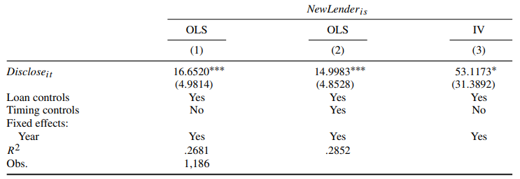
Table 7 – Voluntary disclosure and lender choice: Instrumental variables
Notes:
Book leverage.

Slide 25
Table 7 Takeaways
Again, borrower information sharing is associated with more lender switching on subsequent loans even in the IPO sample

Slide 26
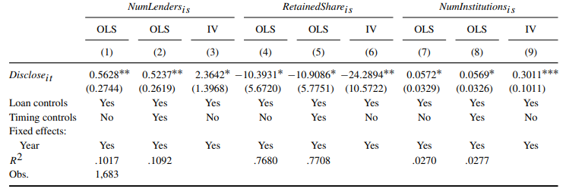
Table 8 – Voluntary disclosure and next syndicate structure: IV

Slide 27
Table 8 Takeaways
Disclosure still affects the composition and structure of lending syndicates

Slide 28
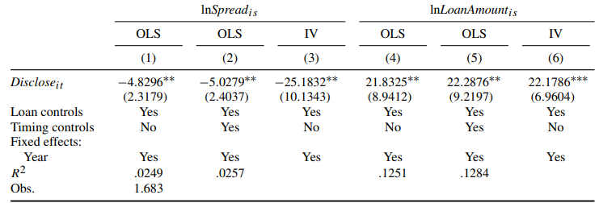
Table 9 – Voluntary disclosure and future loan rates: IV

Slide 29
Table 9 Takeaways
Borrowers who disclose financial information benefit from better loan terms. Even in the IPO sample!

Slide 30
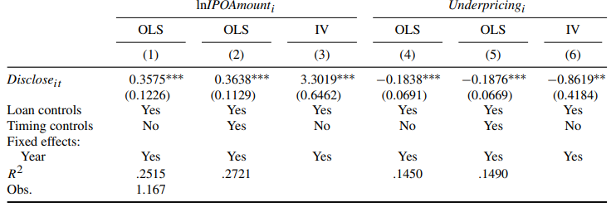
Table 10 – Voluntary disclosure and IPO

Slide 31
Table 10 Takeaways
Voluntary disclosure is significantly associated with higher IPO values
Disclosing firms see lower IPO underpricing

Slide 32
Conclusion
Borrower information sharing reduces lender holdup
Disclosing firms secure improved lending terms
Voluntary disclosure improves IPO outcomes
Disclosing benfits must be balanced with cost of providing information in competitive markets

